Slide 1
A&S: 2000 The Story of Dinosaurs
3: What is a Dinosaur?

Slide 2
Define dinosaur
Gallery Walk
WordCloud

Slide 3
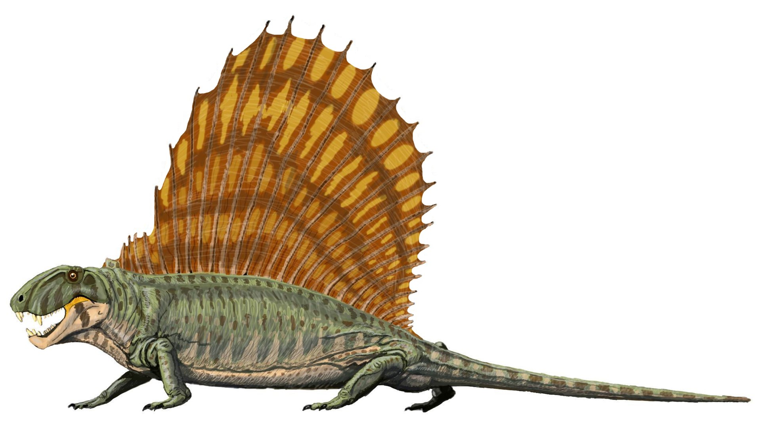
Title

Slide 4
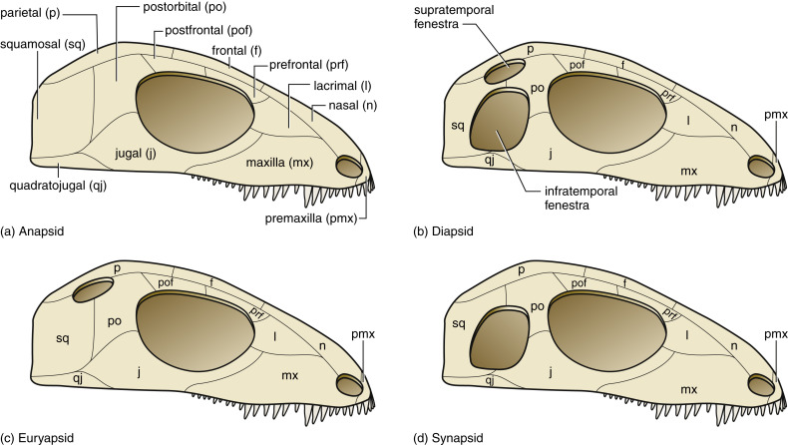
Title

Slide 5
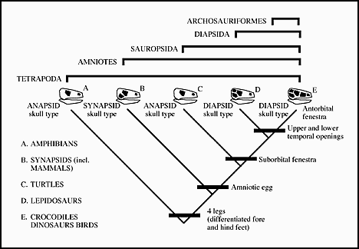
Title

Slide 6
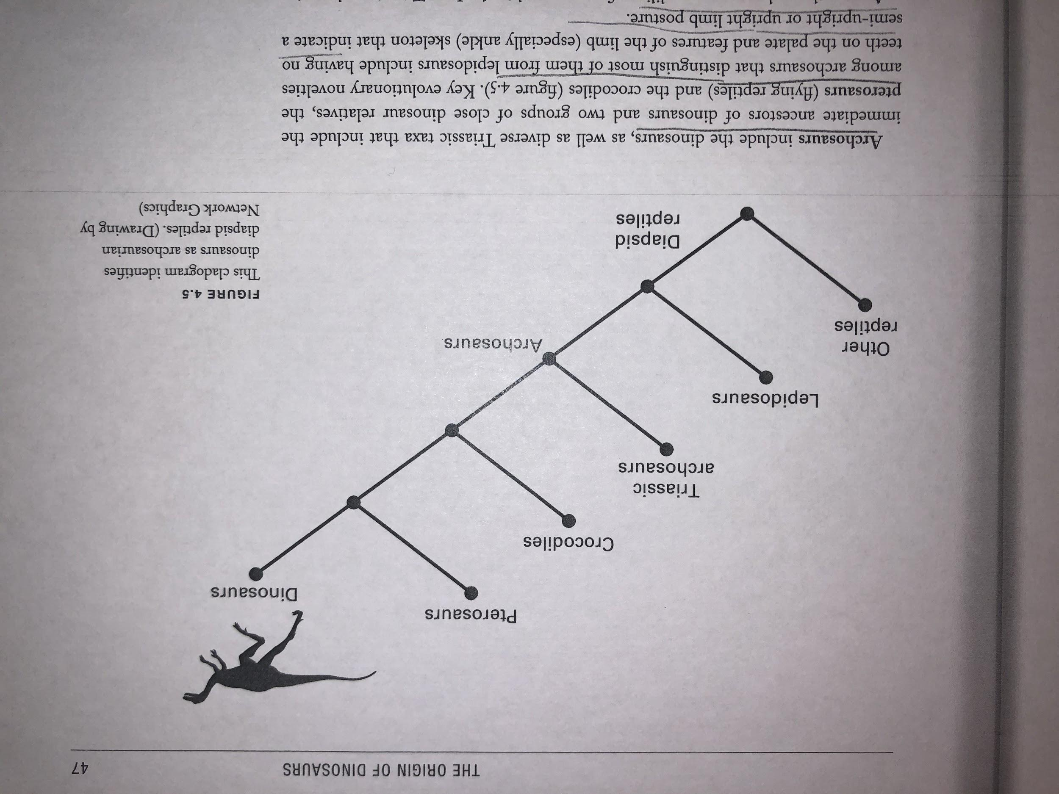
Title

Slide 7
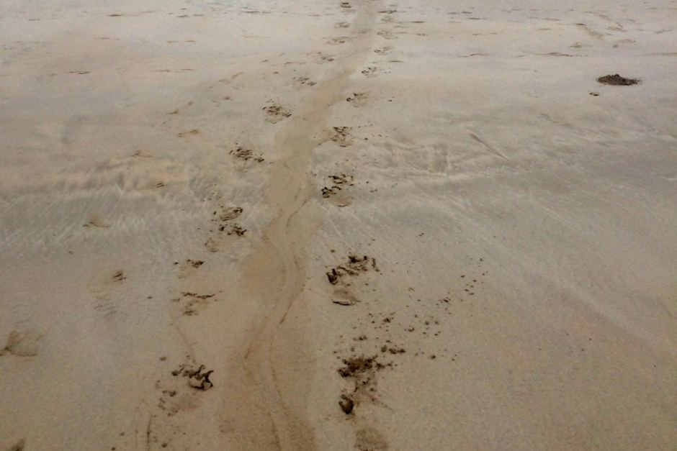
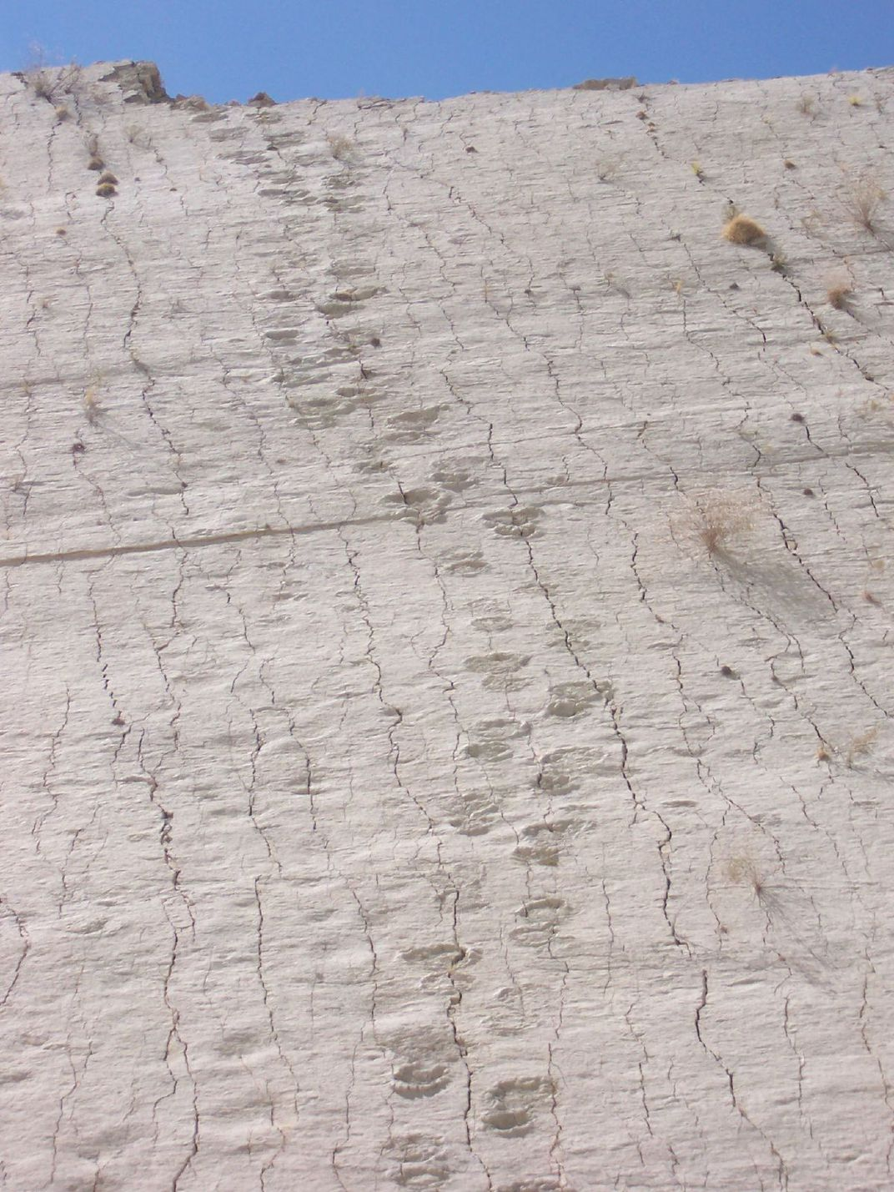
Title

Slide 8
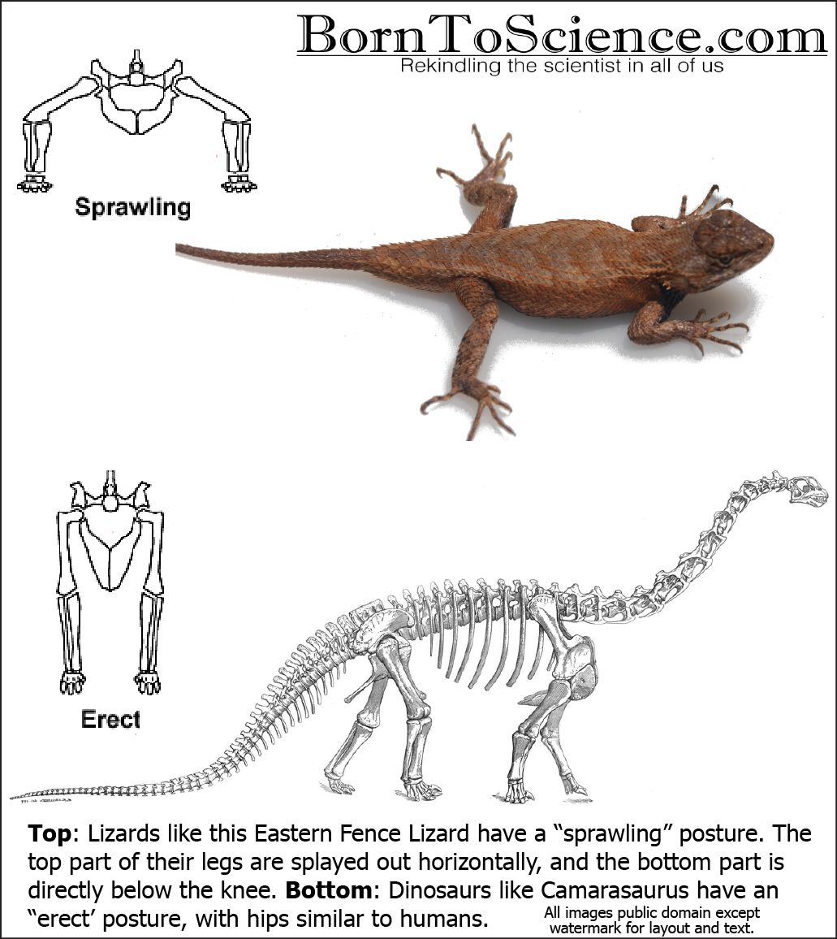
Characteristics of Dinos
What doesn’t qualify...as much?
Diapsids
Amniotic Eggs
Legs directly beneath then
Size
Feeding behavior

Slide 9
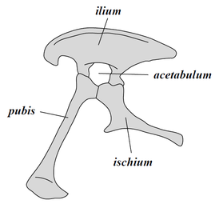
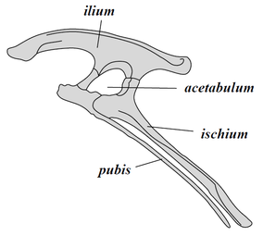
Types of Dinos
Based on hip and tooth structures
Surischichian Pelvis: Lizard-hipped
Ornithischian Pelvis: Bird-hipped

Slide 10
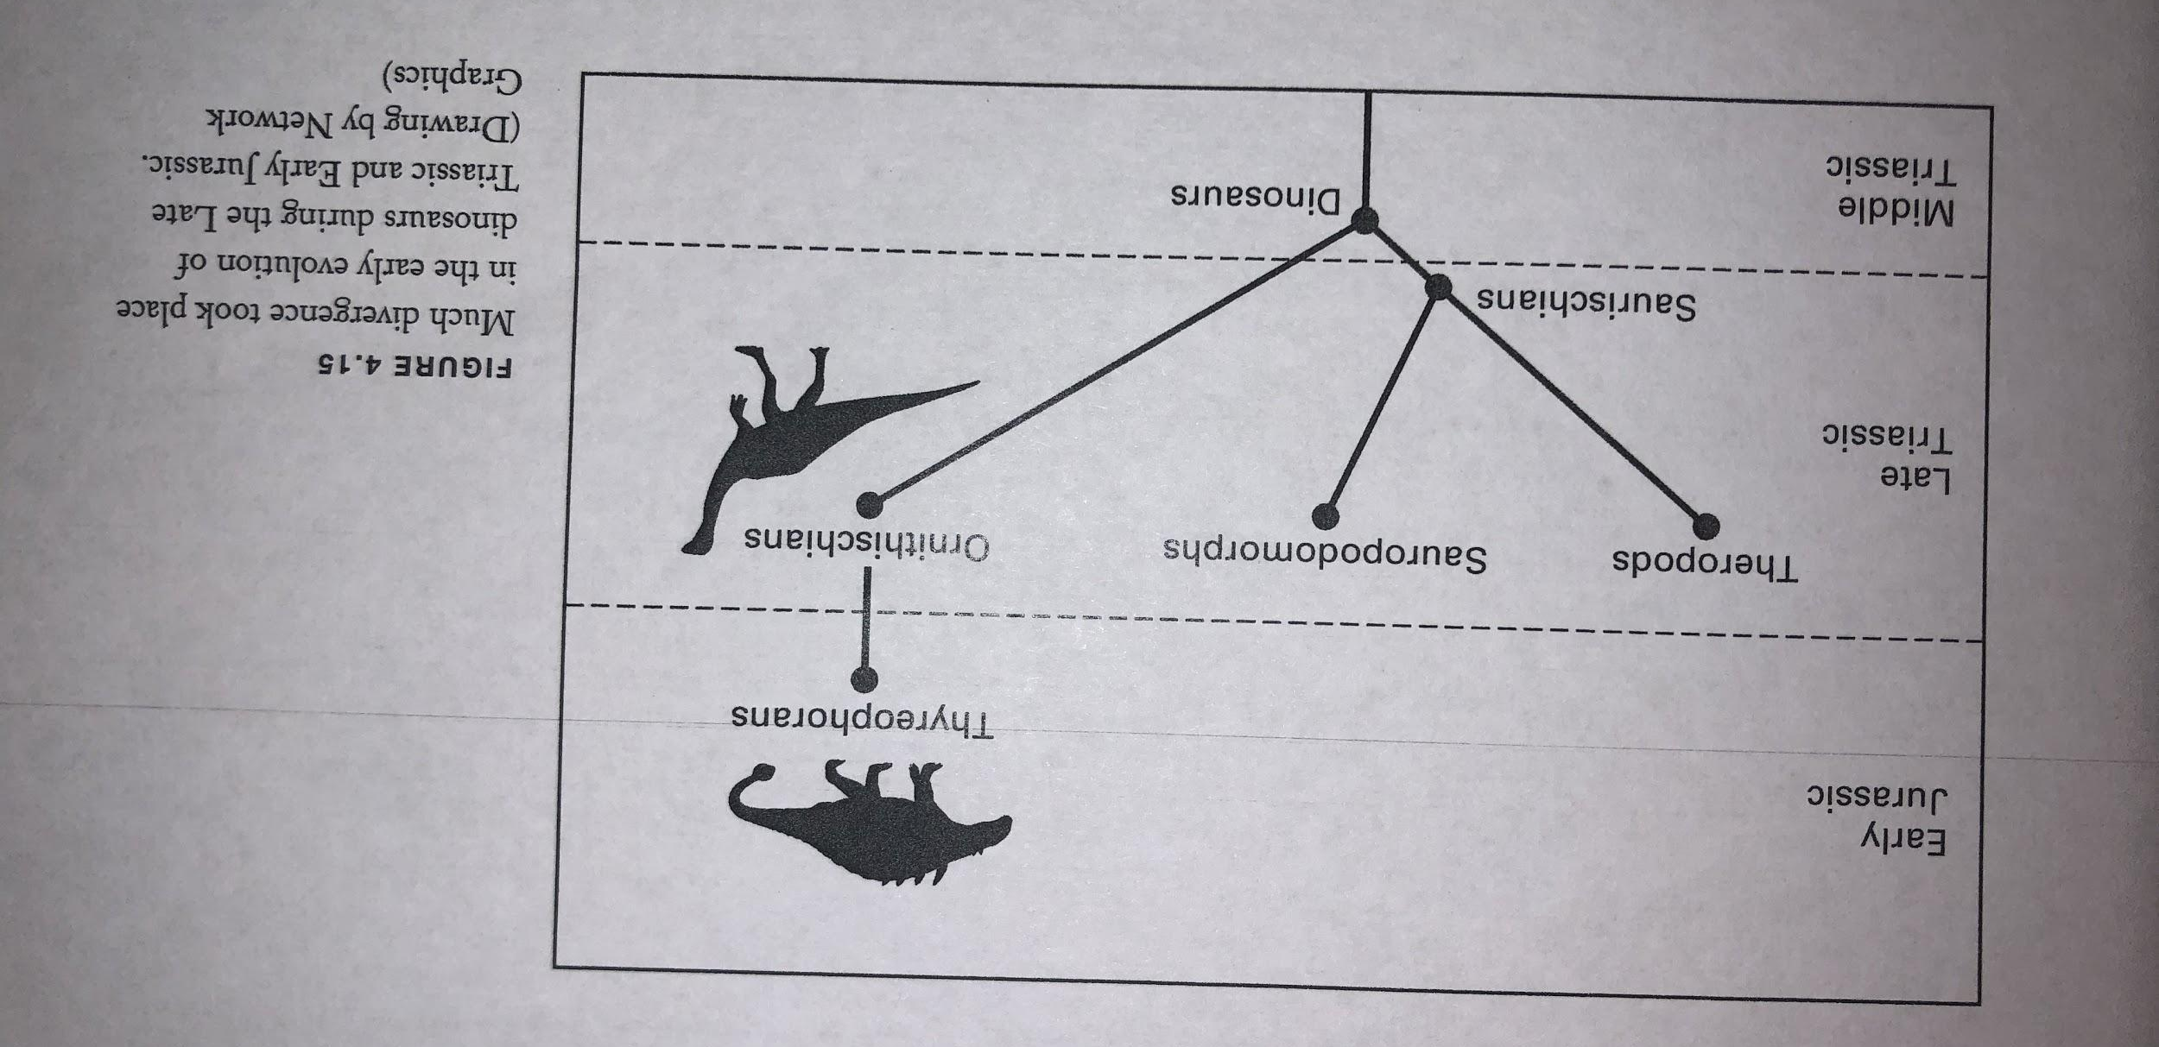
When?

Slide 11
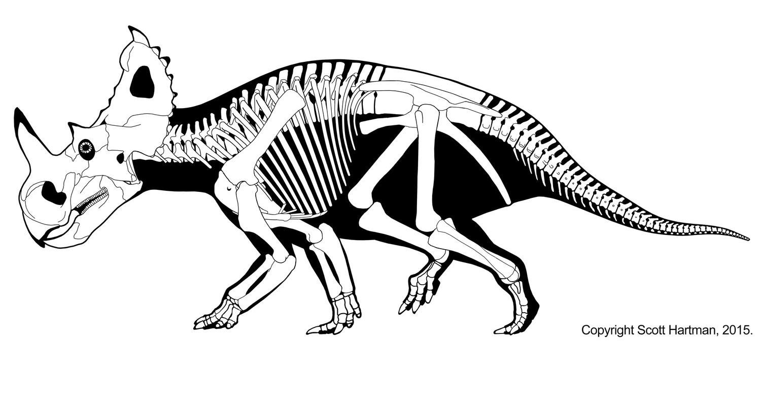
Activity

