Slide 1
GEOL 1003: The Story of Dinosaurs
Lecture 1a: Introduction & Course Expectations

Slide 2
Course Expectations
This course will explore the validity of arguments and/or conclusions in dinosaur research through evaluating the scientific evidence. In this course, students will read, experiment, and evaluate scientific literature surrounding dinosaurs. Students are expected to work with others to evaluate the plausibility of the dinosaur concepts and theories, and hands-on experiments to add additional information to their interpretations. Students will be expected to participate in evaluation mechanisms to assess critical thinking and science literacy. There are no prerequisites and no laboratory component to this course, although hands-on activities will be the primary focus of lecture one day a week.
Class participation is important

Slide 3
Weekly Schedule
Mondays- Introduction of topic, Pre-Quiz
Wednesdays- Hands-on Activity, turned in on Canvas
Fridays- Wrap-up of topic, Post-Quiz

Slide 4
Last Class

Slide 5
Last Class

Slide 6
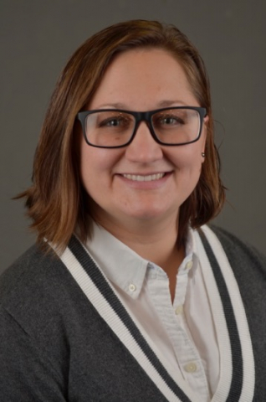
Dr. Ashley Burkett
About me:
I am a micropaleontologist….I do not study Dinosaurs
At OSU Aug 2018. Teaching since 2011.
First time offering this course - online!

Slide 7
Canvas
CANVAS required for this course
Weekly quizzes
Interactive activities
Flipgrid Video Communication
Video Lectures
Communication with classmates and instructor
Please turn on notifications
Expect to work ~3x week on this course.

Slide 8
Entry Survey
Used to evaluate where the class stands at the beginning and end of the course
Anonymous results
Completed on Canvas

