Slide 1
GEOL 1003: The Story of Dinosaurs
Lecture 1b: Scientific Method

Slide 2
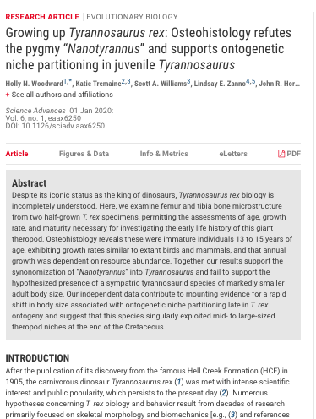
Scientific Paper
How scientists communicate with each other
Sections of the paper
Abstract
Introduction or Background
Methods
Results
Discussion
Conclusions
What can the general public gain from these?

Slide 3
Scientific Method
Hypothesis driven
Gather data to test hypothesis
Make a summary of our findings
Hypothesis can be rejected even if it was supported a thousand times before

Slide 4
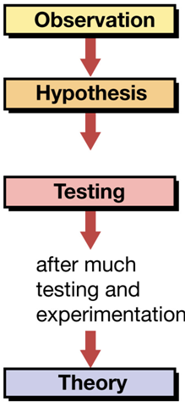
The Scientific Method
Data collection
Observation, measurement
Scientific fact - repeatedly confirmed observation
Hypothesis – tentative, testable explanation based on observations
used to make predictions, which are tested via experimentation or further observation
A hypothesis becomes a theory when it has been repeatedly tested and its predictions verified
Science supports the explanation of the natural world that best explains all available observations

Slide 5
Nature of Scientific Certainty
Testing can prove a hypothesis false, but cannot tell us that a hypothesis is true
Science can tell us what is probably true based on available observations
Science advances by the scientific method
New observations yield new hypotheses
Today, this usually leads to the modification of theories
VLADGRIN/Shutterstock article

